Slide 1

Bayesian Machine Learning
Leverage probabilistic machine learning techniques; Explore:
1.Bayes theorem
2.Classfiers of Naive Bayes
3.LDA
Mengqi Zhao
001672574

Slide 2
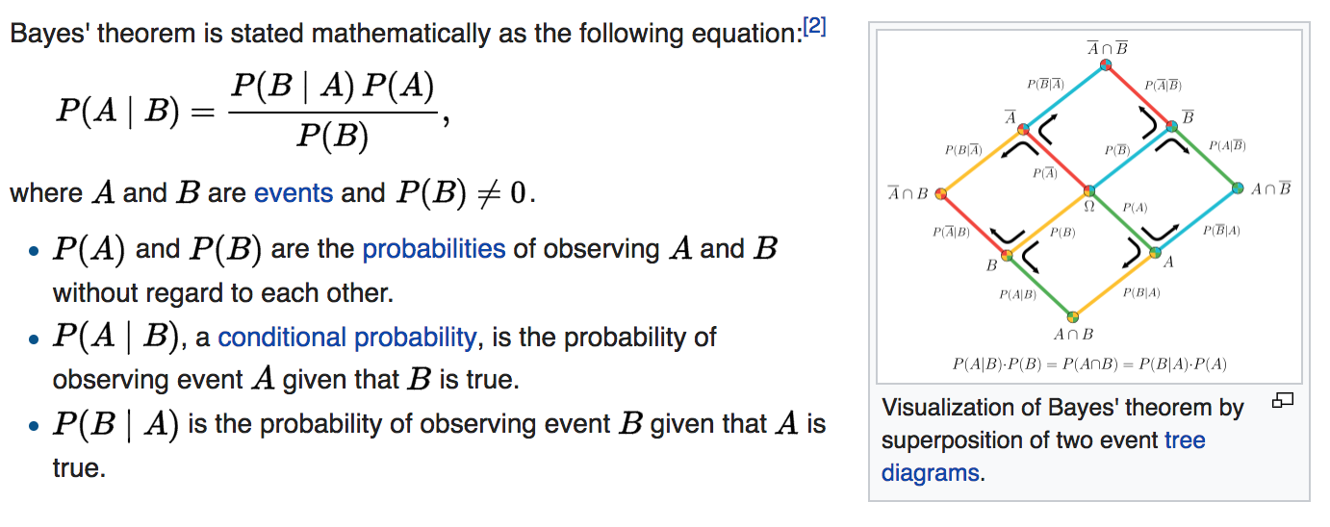
Bayes theorem
What is Bayes theorem ?

Slide 3
Bayes theorem
What is Bayes theorem ?

Slide 4
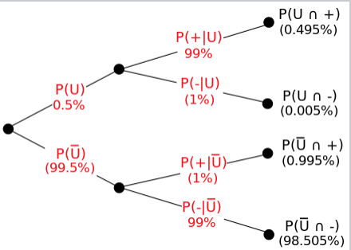
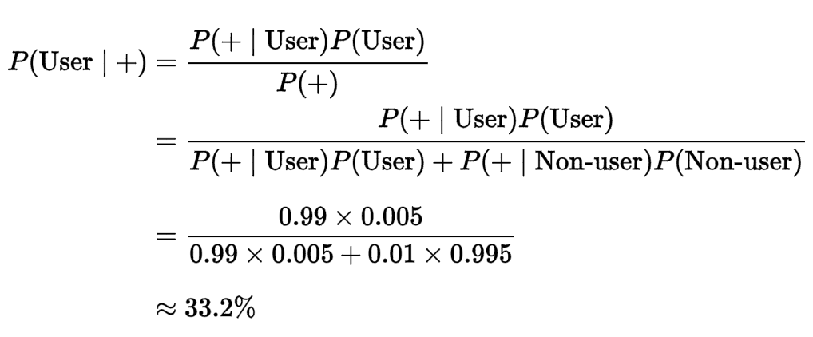
How to use Bayes theorem?
Drug testing
Suppose that a test for using a particular drug is 99% sensitive and 99% specific.
That is, the test will produce 99% true positive results for drug users and 99% true negative results for non-drug users.
Suppose that 0.5% of people are users of the drug.
What is the probability that a randomly selected individual with a positive test is a user?

Slide 5
Then, What is Naive Bayes?
Naive Bayes is a specific part of Bayes.
Bayes might include a lot of Naive Bayes.
What is Classfiers of Naive Bayes?
In machine learning, naive Bayes classifiers are a family of simple probabilistic classifiers based on applying Bayes' theorem with strong (naive) independence assumptions between the features.
1. Missing Data
2. Use Log Probabilities
3. Use Probabilities For Feature Selection

Slide 6
Example - Pima Indians Diabetes Data Set
1. Basic Data from:
https://archive.ics.uci.edu/ml/datasets/Pima+Indians+Diabetes
2. Document Details' Description:
https://archive.ics.uci.edu/ml/machine-learning databases/pima-indians-diabetes/pima-indians-diabetes.names
3. Table and Value:
https://archive.ics.uci.edu/ml/machine-learning-databases/pima-indians-diabetes/pima-indians-diabetes.data

Slide 7
The process
1. Data Ingestion
2. Data cleansing and manipulation
3. Single prediction
4. Multi predication
5. Evaluation accuracy
6. Merge code

Slide 8
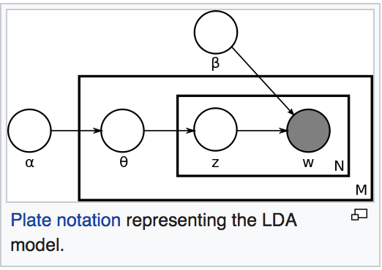
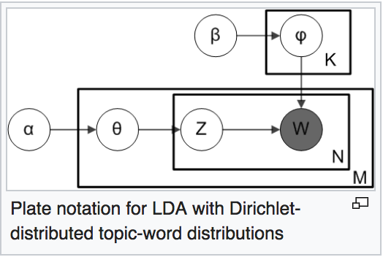
What is LDA
In natural language processing, latent Dirichlet allocation (LDA) is a generative statistical model that allows sets of observations to be explained by unobserved groups that explain why some parts of the data are similar. (what is this mean? It is a model to describe human language including words, sentence and topic.)

Slide 9
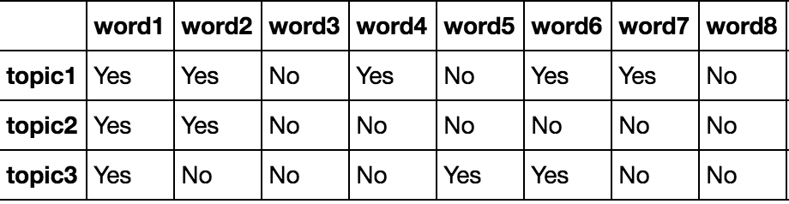
Two Examples of LDA
One is LDA Modeling of Movie Comments
library includes: pandas nltk corpus stopwords wordnet gensim pyldavis

Slide 10
1.LDA Modeling of Movie Comments
1. Basic Data from:
http://text-analytics101.rxnlp.com/2011/07/user-review-datasets_20.html
2. Table and Value: rt-polarity.txt
3. Process:
data preprocessing
add log for recording the model fitting data while training
all the text documents combined is known as corpus.
predicting(classifying) new(existing) docs

Slide 11
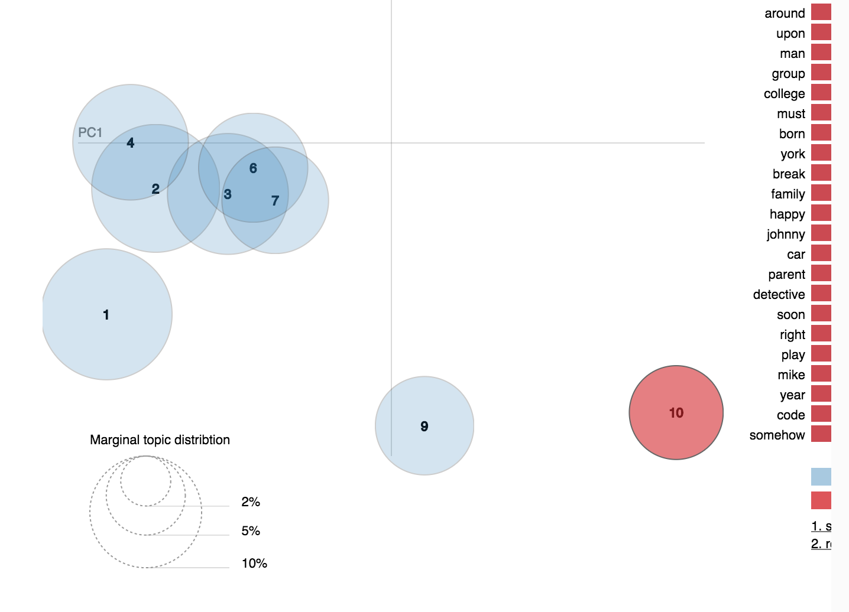
The result of Chart

Slide 12
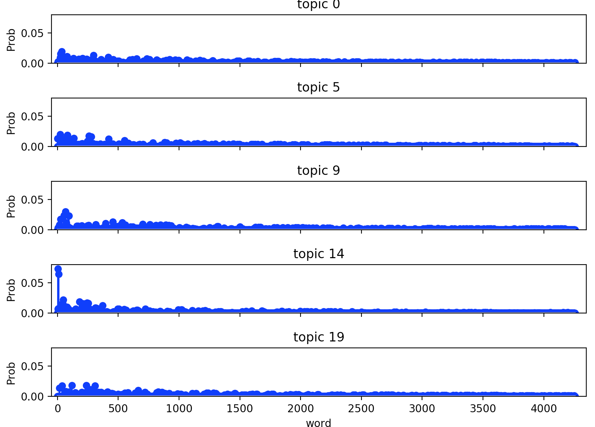
2. Processing Text LDA Model
library includes: numpy lda lda.datasets

